Slide 1
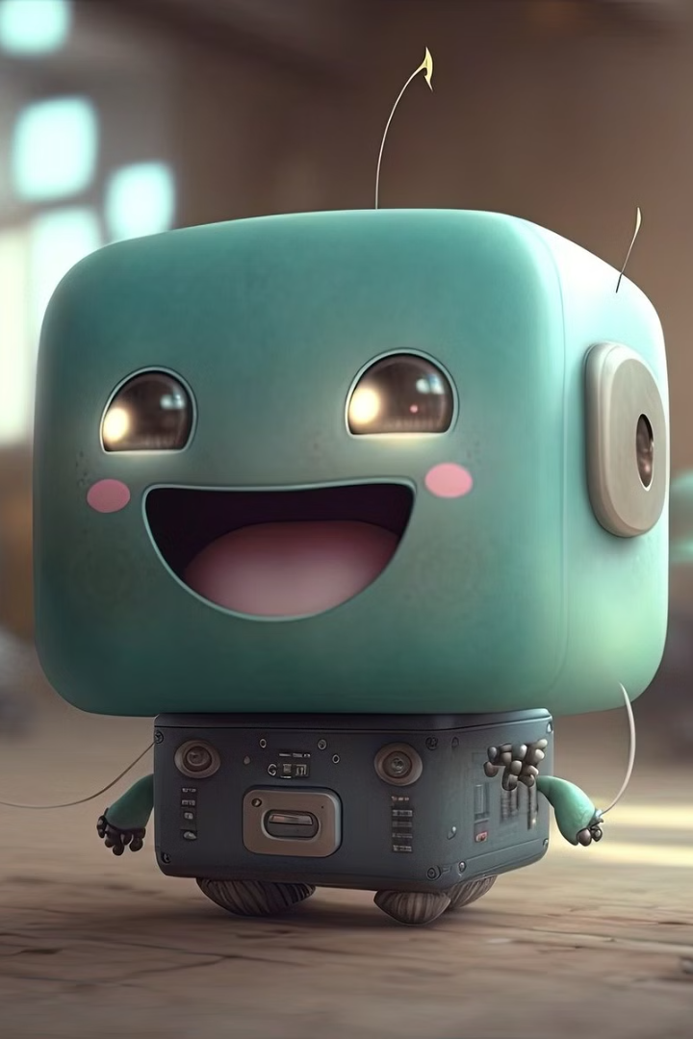
Machine Learning, Deep Learning, and Generative AI: What's the Difference?
Imagine teaching a robot new tricks! We'll learn about three cool ways robots learn. It's like teaching a dog to sit, stay, and roll over, but for computers!
Presented by Ali Askari

Slide 2

Machine Learning: Learning from Examples
What it is:
Example:
How it works:
Real-world example:
Teaching a computer by showing it lots of examples.
Sorting toys! You show the computer lots of toy pictures.
The computer learns the difference to sort new toys!
Email spam filters. They learn to recognize spam emails. 99% accuracy as of 2023.
Presented by Ali Askari

Slide 3
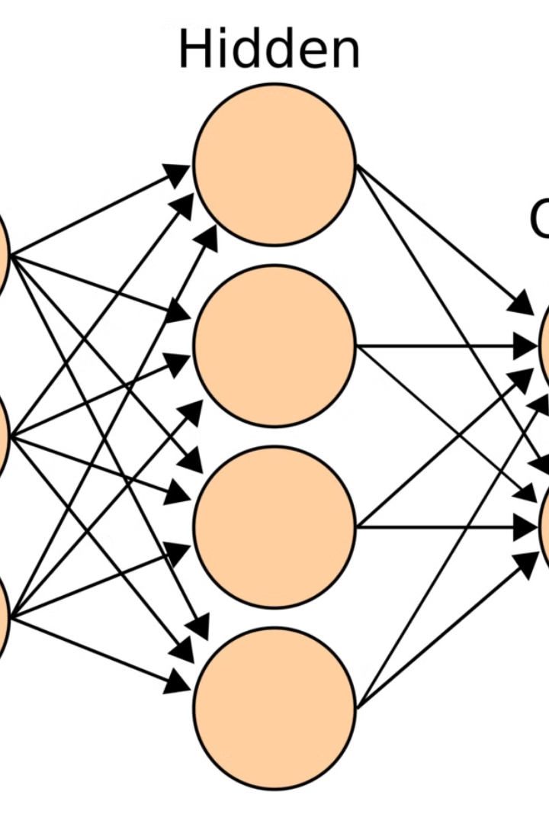
Deep Learning: Smarter Learning with Brain-Like Networks
1
What it is:
2
Example:
A more advanced way of machine learning. It uses "brains" with lots of layers.
Recognizing faces! Deep learning can learn to recognize your face.
3
How it works:
The computer looks at small picture parts to recognize your face.
Presented by Ali Askari

Slide 4




Generative AI: Creating New Things!
What it is:
Example:
How it works:
Teaching a computer to make new things. These things look real.
Drawing a picture of a unicorn! Ask the computer to draw it.
Learns from pictures and creates a unicorn.
Presented by Ali Askari

Slide 5
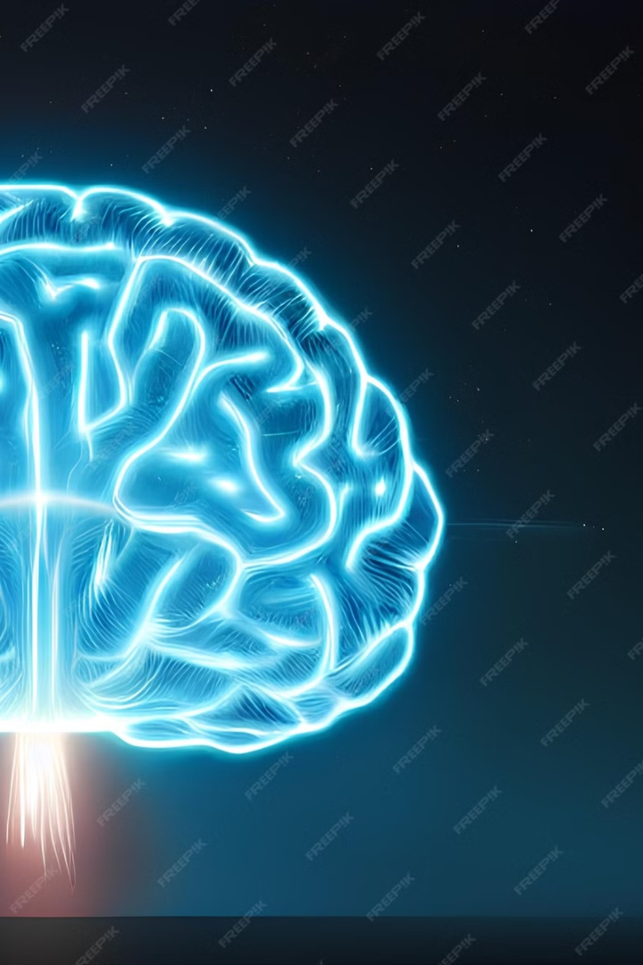



Machine Learning vs. Deep Learning vs. Generative AI:
Machine Learning:
Learning from examples to make decisions.
Deep Learning:
A special kind of machine learning using brain-like networks.
Generative AI:
Creating new and original content.
Presented by Ali Askari

Slide 6
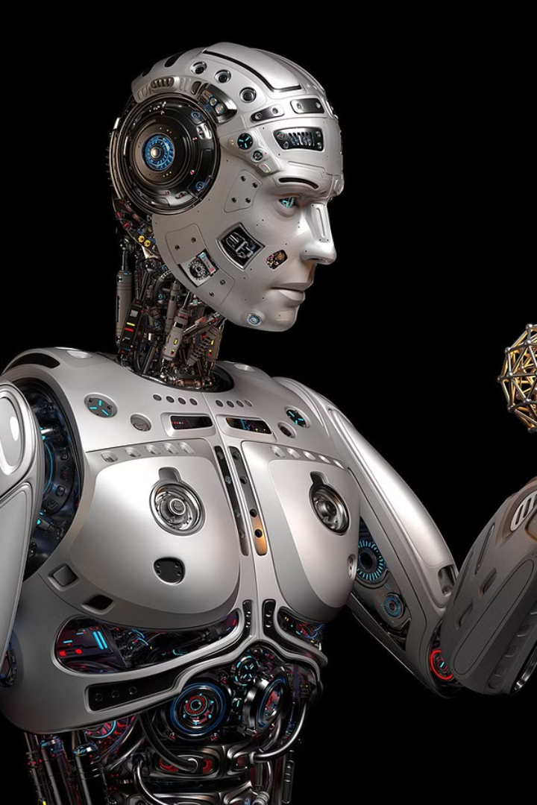
Recap: Robots Are Getting Smarter!
1
Learning:
Machine Learning learns from data.
2
Smarter:
Deep Learning uses brain-like networks.
3
Creating:
Generative AI makes new content.
4
Used Everywhere:
From emails to cars to art!
Presented by Ali Askari

Slide 7





Thanks for watching my presentation
If you like my presentation that please drop a ♥
Facebook
Twitter
LinkedIn
Github
©2025 Ali's Presentation (ML, DL and Gen AI) | All Rights Reserved
Privacy Policy | Terms of Service

